Slide 1
AB 540 and the California Dream Act Application (CADAA)
Training and Outreach Unit
California Student Aid Commission

Slide 2

Learning Objectives
Actively participate and ask clarifying questions to increase understanding of the Dream Act Application (CADAA)
Gain insight on AB 540 requirements
Understand application pitfalls
Utilize these practices to comply with statute
Notes:
We hope that you find this webinar helpful, and that attendees will employ these practices when working with the Transfer Entitlement program.

Slide 3
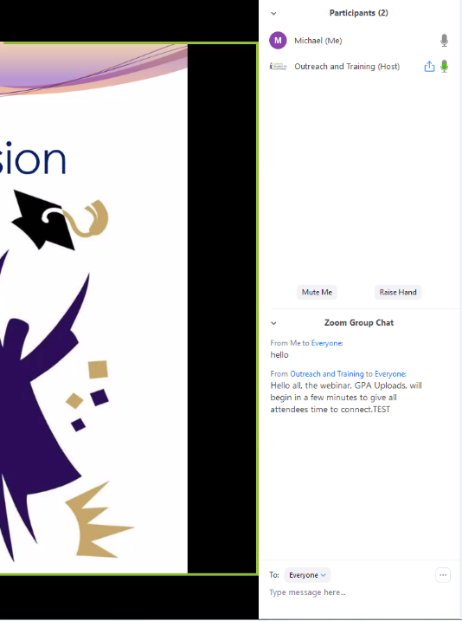
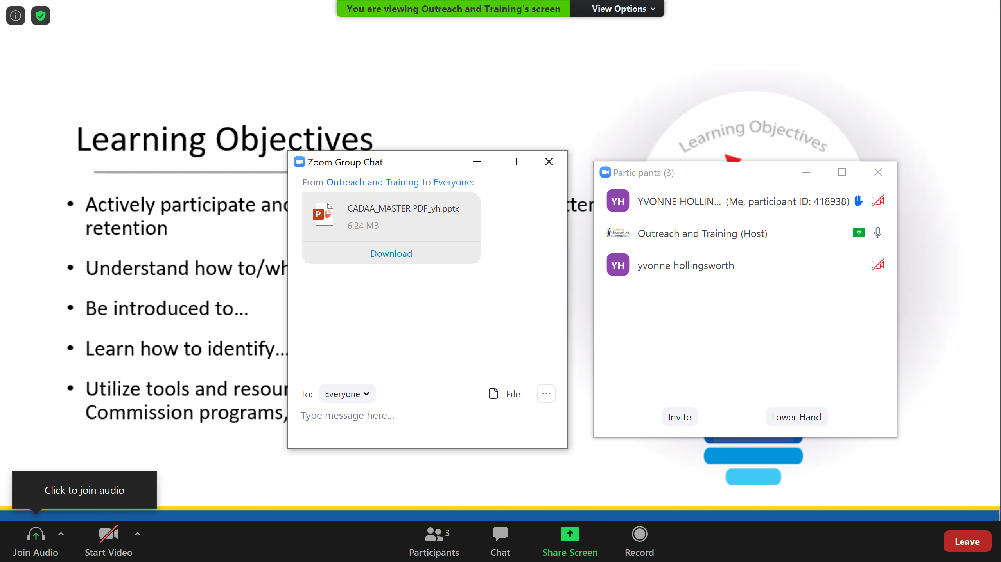
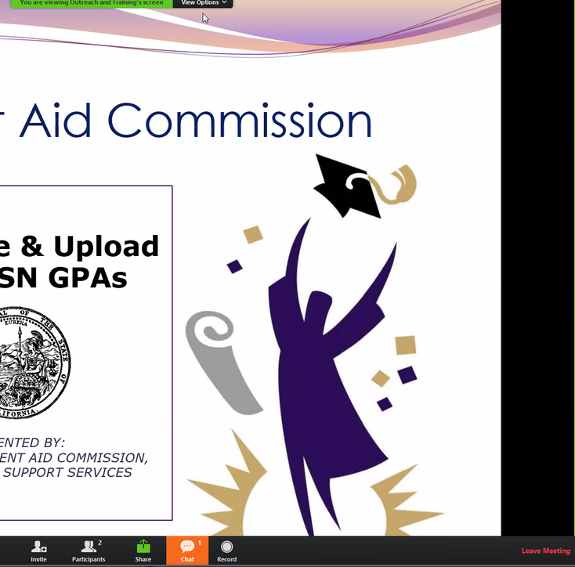
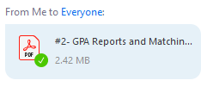

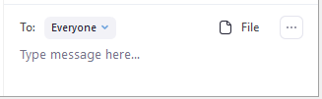

In Today’s Webinar…
Phones will be muted to eliminate background noise
Type questions “to everyone” into the Chat window. Staff is available to answer your questions real time.
  “Chat” is accessed from the bottom of the screen and will be docked to one side of your viewing window.
  A PDF of this webinar can be downloaded from the “File” icon
Open “Participants” window to raise hand to be called on.
Notes:
Phones are muted in order to eliminate background noise.
(CLICK) If you have questions, please open the Chat pod on the right hand side of the screen to type your questions ”to everyone”. I have staff online with me to answer your questions in real-time, throughout the presentation. A PDF version of this PowerPoint can also be downloaded from the “Files” pod in the chat window.
(CLICK) At the end of the webinar, we answer any remaining questions by unmuting your audio, and asking attendees to use the “Raise Hand” feature to be called on so you can verbally ask your final questions.
Lastly, all student information presented today is fictitious.

Slide 4
Agenda
CADAA Updates
1
2
AB 540
3
WebGrants
Resources
4
Notes:
Here is today’s agenda. We will briefly cover the most important aspects of each of these topics:
The Cal Grant application process
The role that GPAs play in Cal Grant consideration
Both basic financial aid eligibility requirements, as well as additional financial criteria, like the maximum income and assets a family can earn and still qualify for a Cal Grant
Award Cycles: Entitlement & Competitive. it’s important for attendees to understand what is needed to give students the best chance to earn a Cal Grant
Cal Grants ABC
WebGrants 4 Students- this is the student portal that students use to claim their Cal Grant
And finally, we will leave you with some valuable resources

Slide 5
Dream Act Application Updates
Notes:
We would now like to go over some additional updates and resources available to you.

Slide 6
Competitive Cal Grants for CADAA Applicants
Effective 2019-20, the number of Competitive Cal Grant award offers was increased to 41,000
CADAA and FAFSA filers now are given equal consideration for competitive awards.
GPAs for CADAA applicants can be submitted through the SSN GPA upload option using the student’s Dream Act ID or through the Non-SSN GPA upload process.
Notes:
Schools should ensure they submit enrollment data to the Commission for all CADAA applicants as well as FAFSA applicants regardless of the number of units in which the student is enrolled. Please use the student’s Dream Act ID to submit enrollment data for CADAA applicants. Submit verified GPAs for FAFSA and CADAA applicants by the September 2, 2019 application deadline. GPAs for CADAA applicants can be submitted through the SSN GPA upload option using the student’s Dream Act ID, or through the Non-SSN GPA upload process. CCC re-established GPAs should be identified by choosing the reestablished check box before uploading (only available in the SSN GPA upload option at this time). When uploading both regular and re-established GPAs, each requires a separate data file upload

Slide 7
California DREAM Loan Program for Graduate Degree Programs
AB 540 Eligible
Attend a CSU or a UC
Complete a DREAM Act Application
Sufficient financial need
Course of study must qualify as an eligible program under Cal Grant guidelines
Enrolled in a program leading to a professional or graduate degree
Eligibility
Requirements
DREAM
Loan Terms
Annual loan maximum: $4,000
Aggregate maximum: $20,000 at any one institution
Annual promissory note
Interest rate matches Subsidized Direct Loan rate for that same year
Notes:
Now available for undergraduates and graduate students at CSUs and UCs
Senate Bill 354 will go into effect starting in the 2020-21 academic school year, expanding eligibility for the California DREAM Loan Program to graduate programs at California State and University of California campuses. It is estimated that 500 graduate students will become eligible to receive loans under this bill, according to the CSU and UC.

Slide 8
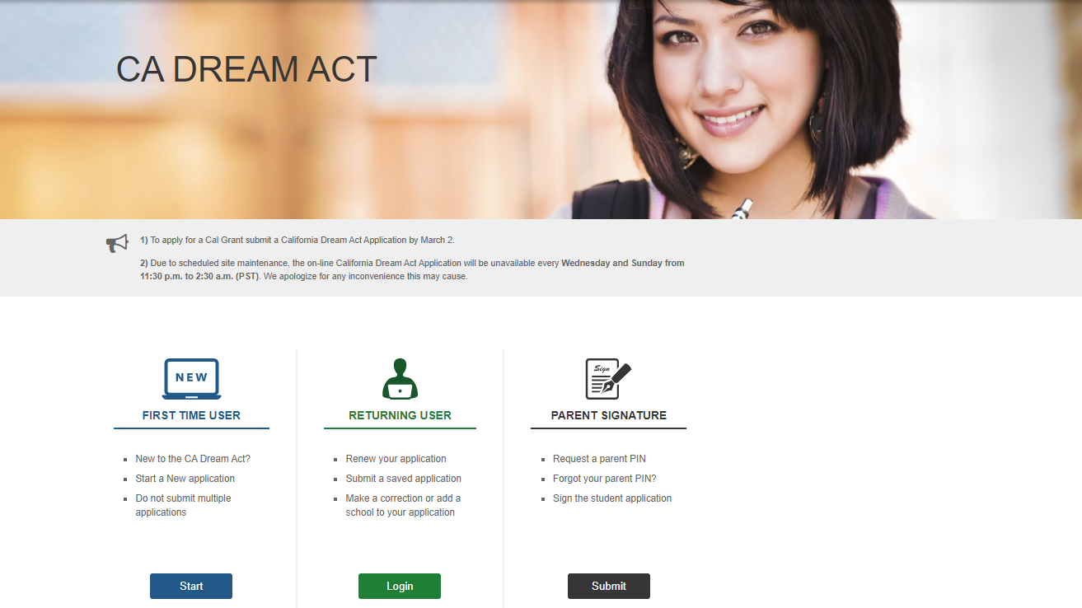

2020-21 CADAA: Updated Look
Notes:
The California Dream Act Application, commonly referred to as CADAA, has a new look. The basic functionality is the same.

Slide 9
AB 540
Notes:
We would now like to go over some additional updates and resources available to you.

Slide 10

AB 540 Requirements
1. Time and Coursework
Option A:
3 years high school credits and 3 years total attendance at any of these schools in California:
Option B (SB 68):
3 years attendance (or equivalent) at any of these schools in California:
High School
Adult School
Community College*
  * Maximum of 2 years of community college may be applied towards 3-year SB 68 requirement
Elementary School
Middle School
High School
Notes:
SB 68 further expands AB 540 eligibility. Students can now meet AB 540 criterial by counting years spent at a California Community College or adult school, by the completion of an Associate’s Degree or by meeting the requirements to transfer to UC or CSU. As of Jan 1, 2018, California Education Code expanded on some of the requirements under AB 540. To be eligible under AB540, students must meet 3 requirements. In the first requirement, SB 68 expands on the equivalency of high school attendance to include adult schools, county office of education, unified school district or high school district, the Department of Corrections and Rehabilitation, and California Community Colleges. This expansion directly benefits students who do not have a CA high school diploma or GED.

Slide 11

AB 540 Requirements
Degree or Transfer Eligibility
  Graduation from a California High School (or the equivalent, GED, HiSET, TASC, CHSPE) or
  Earned an associate’s degree from a California Community College or
  Met the minimum requirements to transfer to a CSU or UC
Non-resident Tuition Exemption
  Student files waiver (AB 540 affidavit) with the college or university
Notes:
For the second requirement, SB 68 expanded the high school graduation requirements to include an earned associates degree from a CA Community College; or by meeting the minimum transfer requirements at a CSU or UC.
Lastly, for those with unlawful immigration status, the Non-resident Tuition Exemption waiver declaring that the student has filed or will file an application to legalize their immigration status must be submitted. The affidavit exempts qualifying students from paying nonresident tuition & certifies that students are eligible to apply for Cal Grant under the CADAA.

Slide 12
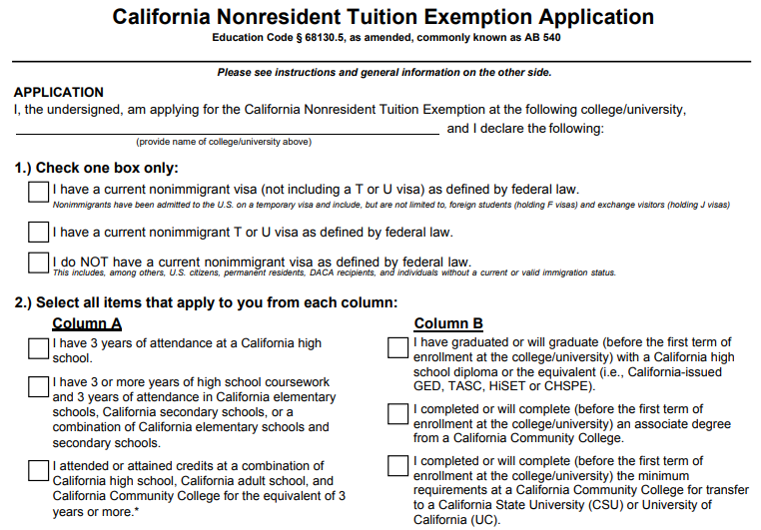




AB 540 Affidavit
Undocumented students who are eligible for a non-resident tuition exception must complete and submit the AB 540 Affidavit to the admissions office at their college of attendance.
Notes:
The AB 540 Affidavit serves two purposes; one is to verify that the student meets the educational requirements, and the second is to certify the intent to establish legal residency.

Slide 13

Best Practices
Ensure collection and distribution of non-resident tuition exemption form between Financial Aid Office and Admissions & Records.
  Schools will be required to produce records during a compliance review
  Most CADAA filers do not realize they are required to have an AB 540 Affidavit on file (or even know what it is).
Train all staff on AB 540 eligibility, including proper state residency determination.
Confirm your Financial Aid Management System (FAMS) codes AB 540 students appropriately.
Update AB 540 verification policies & procedures as needed when state and federal regulations change.
Customizing your roster is one way to identify your CADAA applicants.
The other way to search your students’ ISIRs is to download the information from a report.
Notes:
Here are some best practices when working with your AB 540 eligible students. Ensure collection and distribution of non-resident tuition exemption form between Financial Aid Office and Admissions & Records.
Train all staff on AB 540 eligibility, including proper state residency determination.
Confirm your Financial Aid Management System (FAMS) codes AB 540 students appropriately.
Update AB 540 verification policies & procedures as needed when state and federal regulations change.
Remember that most CADAA filers do not realize they are required to have an AB 540 Affidavit on file (or even know what it is).

Slide 14
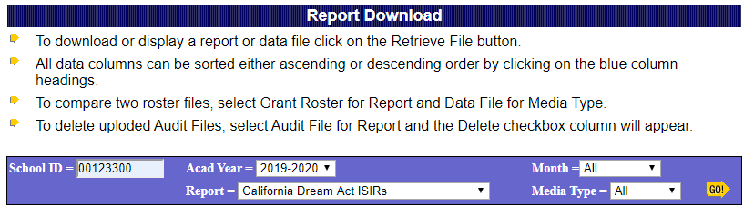
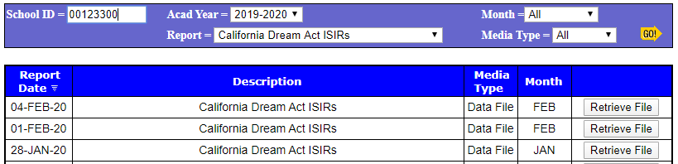
California Dream Act ISIRs
Portal Menu
Data Transfer
Report Download
The raw data may be imported to your school’s financial management system
Notes:
The other way to search your student’s ISIR is to download the information from a report. To download the reports for the ISIRs, begin at the portal menu, select “data transfer,” and then select “report download.” You will be brought to this menu, the report download screen. Your School ID will pre-populate. Next you will choose the academic year from the drop down menu. We’re searching for the “CA Dream Act ISIRs” report from the menu.
After you select the report, you will select “retrieve file.” The raw data may be imported to your school’s financial management system to use with your software. Or, you can take the raw data and convert it by using the Cal ISIR Tool from the “Tools” link located in WebGrants.
The Cal ISIR tools are used to open and view Cal ISIRs in an Excel format.

Slide 15

Non-Immigrant Visas and TPS
Only Temporary Protected Status (TPS) holders or U Visa holders are eligible for AB 540:
TPS or U Visa holders should file CADAA
T Visa holders should file FAFSA
Countries with TPS status can change
Notes:
TPS:
“Temporary Protected Status,” is assigned by the Secretary of Homeland Security, due to conditions in the country that temporarily prevent the country's nationals from returning safely, or in certain circumstances, where the country is unable to handle the return of its nationals adequately. For example, an ongoing armed conflict, an environmental disaster, or an epidemic. TPS is a temporary benefit that does not lead to lawful permanent resident status or give any other immigration status. Countries currently designated for TPS include: El Salvador, Haiti, Honduras, Nepal, Nicaragua, Somalia, Sudan, South Sudan, Syria, Yemen.
U Visa and TPS holders are not eligible for federal student financial aid, but can apply for the CADAA:
U Visa:
A nonimmigrant visa which is set aside for victims of crimes (and their immediate family members) who have suffered substantial mental or physical abuse and are willing to assist law enforcement and government officials in the investigation or prosecution of the criminal activity.
T Visa:
Allows certain victims of human trafficking and immediate family members to remain and work temporarily in the United States, typically if they agree to assist law enforcement in testifying against the perpetrators.
T Visa holders are eligible to apply for federal financial aid and should file a FAFSA as “eligible non-citizens.”
Overstaying a visa:
It is estimated that via overstays account for 50% of undocumented immigrants in the U.S., and the Department of Homeland Security (DHS) reports that almost 3% of overstays are exchange students. F, M, j-1 visas are being targeted as a result.
The Trump administration has redefined “unlawful presence”, to begin on the date the visa expired; versus the date that the government discovered the violation. In addition, penalties for violators were increased. Previously, students could renew/update their visa in their home country, and potentially return to U.S. Current law now bans violators who overstay their visa by 180 days from returning to the U.S. for either 3 or 10 yrs.

Slide 16
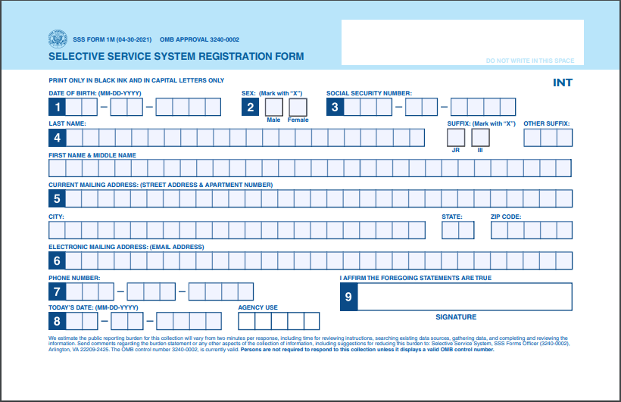
Selective Service
All males between ages 18-25 are required to register for Selective Service.
Students within three months of their 18th birthday can register by mail.
Mail paper registration form. Registration card takes 2-3 months to arrives by mail.
SSN is not required to register. SSN field should be left blank.
CSAC does not share student data with Selective Service.
One of the TOP REASONS CADAA filers do not get paid in their first term.
Notes:
Let’s discuss the Selective Service requirement.
Males between the ages of 18-25, regardless of immigration status, must register for Selective Service in order to receive state or federal financial aid.
To assuage fears/concerns from students and their families who are nervous about registering, because they fear their undocumented immigration status will be shared:
Assure students that the Selective Service website states that they do not share information about a male’s citizenship status. Please make your students aware of this and emphasize that it is a requirement for financial aid.
CSAC does not share student data with Selective Service, and is committed to protecting the privacy and immigration status of students

Slide 17
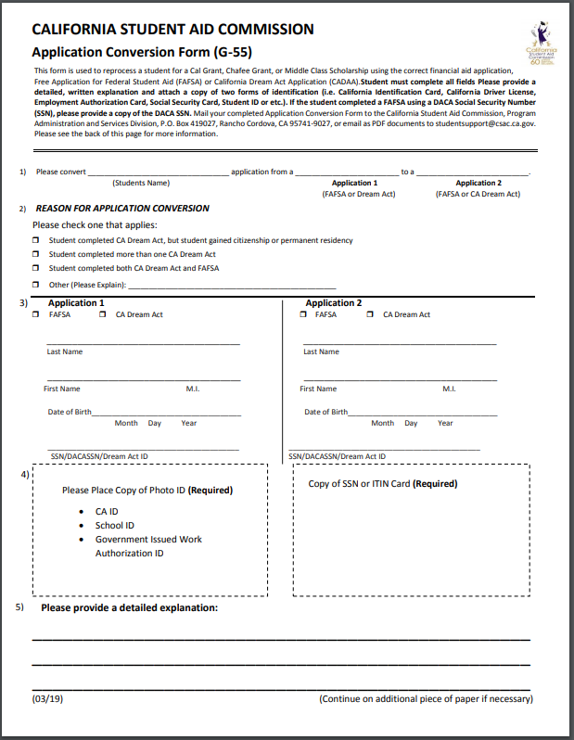
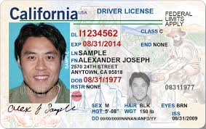

Application Conversions
G-55 Form
Application conversions are necessary when students:
Complete the FAFSA instead of the CADAA
Complete the CADAA instead of the FAFSA
Complete an application for the wrong year
Submit duplicate applications
Gain permanent residency or citizenship
Student must first complete and successfully submit the correct financial aid application.
School then submits the Application Conversation Form G-55 with the corresponding documentation.
Notes:
A typical problem that arises with many Dreamers is they complete a FAFSA with their DACA SSN, instead of the CA Dream Act Application. Similarly, the reverse
What should the student do?
Student completes the Dream Act application.
Student/school submits G-55 Application Conversion Form with DACA SSN and Dream ID
CSAC will process the application conversion.

Slide 18
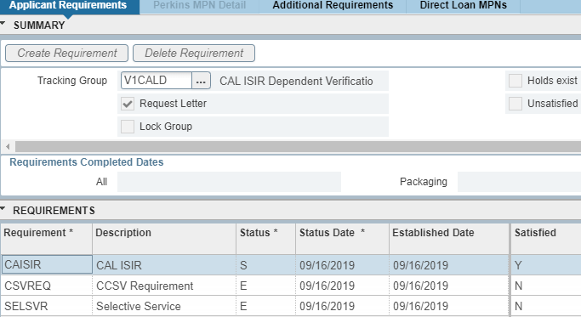
CADAA Verification
20% of CADAA applicants are randomly chosen for verification.
  Federal V1- Standard Verification Group
  AB 540 eligibility
  Students/parents residing in the United States file US tax returns, if they meet earning threshold
Complete verification prior
to disbursing funds.
Screenshot from Banner
Notes:
The Commission randomly selects 20% of applicants for verification. As the institution verifying eligibility, our guidance is that you should follow the federal v1 verification criteria (# in household, # household members in college, student income, parent income) and to treat all your students equally. As a reminder, CADAA eligibility includes, once again, collecting the affidavit from your Cal Grant eligible students.

Slide 19
WebGrants
Notes:
We would now like to go over some additional updates and resources available to you.

Slide 20
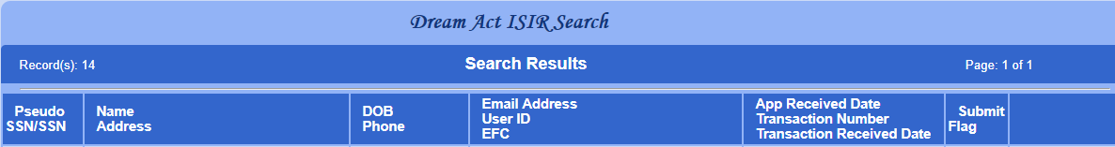
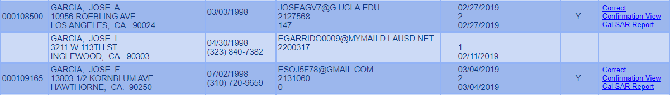
Dream Act ISIR Search
Identify and reach out to students with incomplete applications:
No Dream ID
No EFC
Submit Flag blank
Links to Correction screen, Confirmation View, or Cal SAR unavailable
BESTSTUDENT@GMAIL.COM
000123456
123 A ST
OVERACHIEVER@ UNI.EDU
1000 UNIVERSITY BLVD
(123) 555-1212
JOSEG123@HOTMAIL.COM
000654321
1234 RAINIER AVE APT #123
SAN FRANCISCO, CA 12345
(415) 555-1212
Notes:
The name search results with a common name will result in many records Let’s talk about some of the information on this page. In looking at this list, notice that the first two students have started, but not yet successfully submitted their applications. We know this because there is no EFC listed and you can see the submit flag area is blank. Because these students have not submitted the application, you will not have access to any of the three links to the far right or into the application.
You can tell the first student’s application was saved and submitted because you will notice that an EFC was generated and there is a “Y” in the “Submit Flag” column. Also, the “Correct,” Confirmation View”, and “Cal SAR Report” links are available to you.
The second student has started but not yet submitted the application because there is no EFC listed and you can see the submit flag area is blank. Because this student has not submitted the application, you will not have access to any of the three links to the far right or into the application.

Slide 21
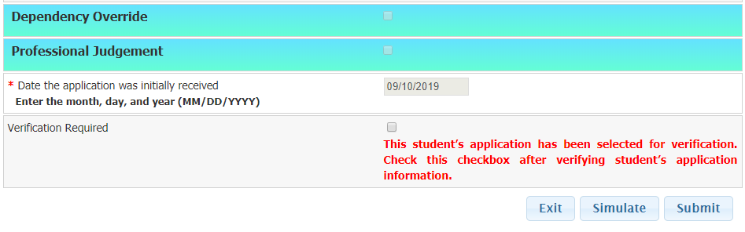
CADAA Correction Screen
Dependency override:
  Functionality available to System Administrators at each campus
Professional Judgement:
  Check “Professional Judgement”
  Submit Grant Record Change (G-21)
  Function available to all users with access to the CADAA menu
Verification Required:
  Check box after verifying application information
System Admins
Submit G-21
Complete Verification
Notes:
Note: Schools sometimes incorrectly think that PJ changes done directly on the Cal-SAR carry over to WebGrants. However, all PJ’s must be accompanied by the G-21 in order to update students’ Cal Grant records. A good rule of thumb is to treat all changes to the CADAA the same as FAFSA.

Slide 22
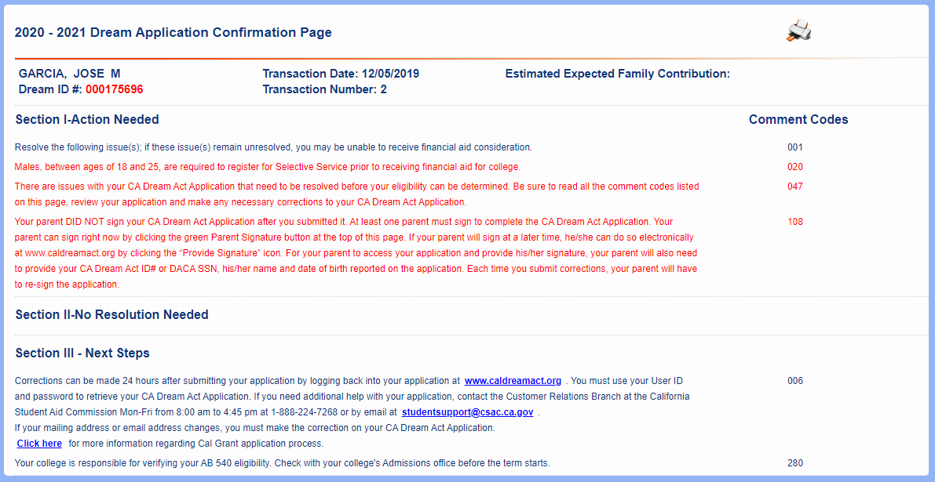
CADAA Confirmation Page
000123445
1412
Issues which need
to be resolved:
Next steps student should consider:
Notes:
Here is the Confirmation View screen. This screen will appear when the “Confirmation View” link is selected from the Dream Act ISIR search that we looked at a few moments ago. Notice the student’s name, Dream ID, and Transaction number are listed in the top left area. Remind students to have their Dream ID whenever they contact the Commission or their college. This screen is the same view that students see on their own Dream Act application.

Slide 23
Resources
Notes:
We would now like to go over some additional updates and resources available to you.

Slide 24
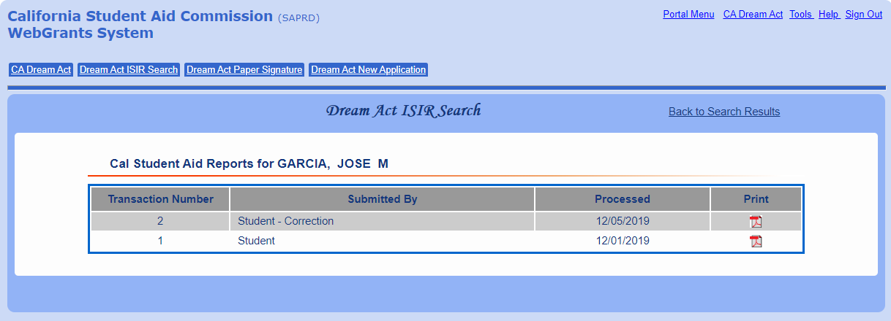
Cal SAR Report
Notes:
This screen will appear if the Cal SAR report link is selected from the Dream Act ISIR Search screen. A Cal SAR is the California Dream Act Student Aid Report, and is the equivalent of the SAR for FASFA filers. The Cal-SAR is basically a transcript of the submitted application. The student or school can choose which ISIR transaction to view or print.
In this screenshot, there are 2 ISIR transactions because the student submitted the initial application, and also made corrections, which generated a new ISIR transaction #2. Remind your dependent students that each transaction must be electronically signed by a parent.

Slide 25

Dreamer Resource Centers
The Student Aid Commission is looking to forge better connections and improved communications with campus Dream Resource Centers throughout the state.
The Commission has created a ‘Dream Act Application/Undocumented Student’ selection as part of our e-mail communications List-Serve.
The Commission, in partnership with our Dreamer Resource Center partners, held the first of three annual CSAC/Dreamer Resource Center Convenings in Q1 of 2020.
Notes:
Read bullet points

Slide 26

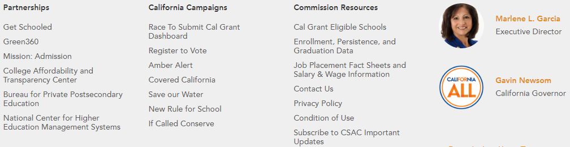
Register for CSAC List-Serv
Updates:
  COVID-19 Updates
  Legislative changes
  System updates, i.e.; WebGrants 4 Students
  Foster Youth programs
Deadline Reminders:
  Community College Enrollment file & GPA Upload
  Annual College Cost Estimate form
  Unpaid Competitive Award Recycle
  SB 70 Data Reporting
  CA License Exam Certification
  Cal Grant/Middle Class Scholarship Reconciliation
  Interest Remittance
Training & Outreach Events:
  Virtual Regional Training Workshops
  Virtual Cash For College workshops
The Commission communicates with schools via List-Serv. Stay up-to-date on Cal Grant and other financial aid-related news.
https://www.csac.ca.gov/
Notes:
The Commission communicates with high schools and colleges via List-Serv. If you’re not already receiving our email alerts, you’re missing out! Sign up for List-Serv by navigating to our main homepage and scrolling all the way to the bottom of the screen.
You’ll receive updates such as legislative changes that impact CSAC programs, system updates, and pertinent deadline reminders. In addition, you’ll receive information about the prestigious Arthur Marmaduke award for outstanding high school counselors; as well as announcements about upcoming training events!
To sign up for the CSAC List Serv, go to the Commission’s homepage of www.csac.ca.gov and scroll all the way to the bottom of the page. http://www.csac.ca.gov/pod/subscribe-list-serv

Slide 27
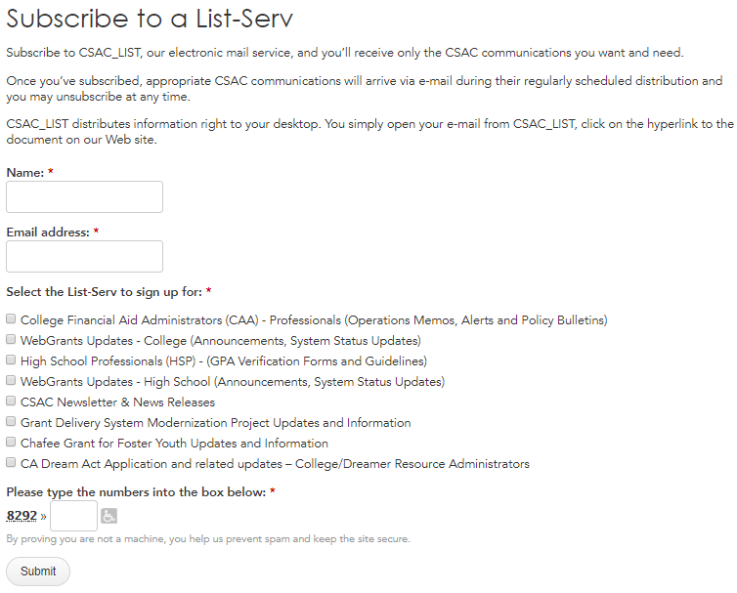
List-Serv
https://www.csac.ca.gov/
Alerts and notifications sent directly to your email
Customize your preferences
NEW! Dream Act/AB 540 Updates!
Notes:
Notice that users can customize the type of alerts they wish to receive, including Chafee and the newly-added Dream Act/AB 540 categories.

Slide 28
Ongoing Training
The Commission offers live webinars, training videos, and annual Regional Training Workshops.
Would you like the Commission to present at your event? Email School Support for a Training Request form
We offer training on a variety of topics:
Cal Grant 101
WebGrants Reports & Tools
Payments Codes & Scenarios
Reconciliation & the Audit Process
California Dream Act Application
Education Level Verification
Middle Class Scholarship
Programs for Foster Youth
For a customized training request form, Contact School Support at: schoolsupport@csac.ca.gov
Notes:
We are currently building our training library, so don’t forget to check back periodically for different offerings. Ad hoc trainings can be requested by emailed schoolsupport@csac.ca.gov to ask for a Training Request form.

Slide 29
New Training Videos!
https://www.csac.ca.gov/post/training-videos
The Commission now offers 5-10 minute training videos on some common and not-so-common tools, reports, processes, and more! We continue to build our training library with new material- so check back periodically.
Training Videos:
Navigating WebGrants
Cal Grant Payment Reporting, Batch Uploads, & Online Roster Award Status Extract Process
Grant Record Changes
Roster Data File Compare Tool
Reconciliation & Program Compliance
Customizing Your Roster
Disbursements & Payments
​Chafee Grant for Foster Youth: Working the Payment Roster
Notes:
The Commission is pleased to announce the addition of new training material to our growing training library.
We’ve added 18 different short, narrated slideshow presentations that are between 5-10 minutes in length. We are actively building additional training content, so check back periodically to see what’s new!

Slide 30


Cal Grant Handbook
https://www.csac.ca.gov/sites/main/files/file-attachments/calgrant_handbook.pdf
Notes:
The Cal Grant handbook provides program overview information, as well as various scenarios and examples.

Slide 31

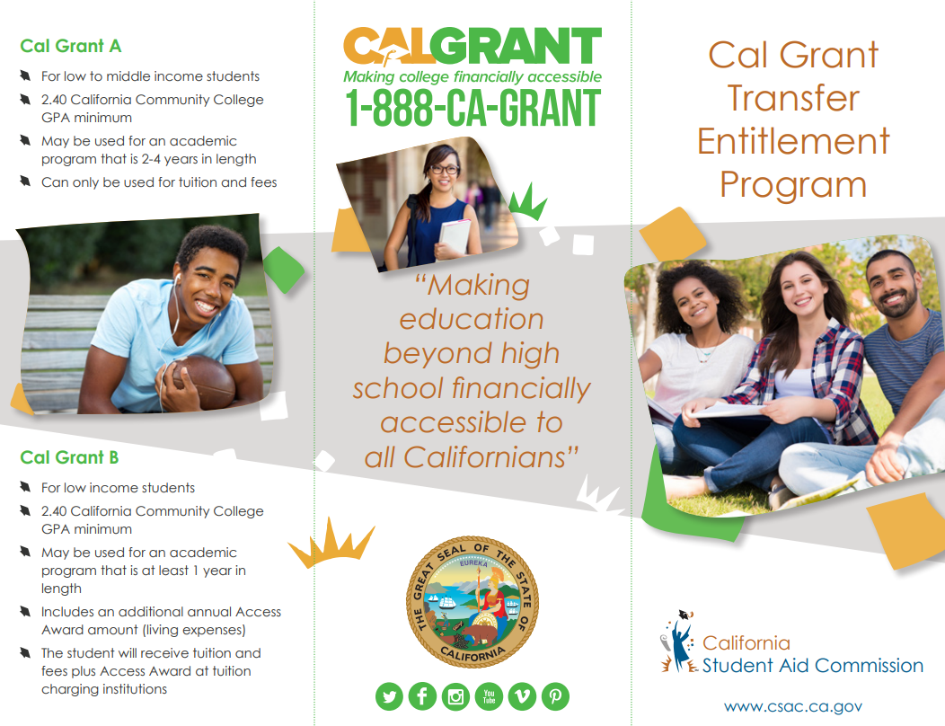
EPubs
Order via Epubs; ship or download for FREE for your next event.
https://www.csac.ca.gov/epubs-ordering-system
Materials are available in multiple languages, on the following programs:
Fund Your Future Magazine
Cal Grant C Brochure
Transfer Entitlement tri-fold
CA Dream Act Application
Middle Class Scholarship
Web Grants 4 Students
Chafee Fact Sheet
Golden State Teacher Grant
Notes:
Transfer Entitlement tri-fold brochures are available and can be shipped free of charge thru E-Pubs. We also have other online and printed publications available in different languages.

Slide 32

www.cash4college.csac.ca.gov
What is a Cash for College workshop?
FREE virtual financial aid application assistance workshops offered in multiple languages
Offered throughout California between 10/1-3/2
Financial aid experts and volunteers assist students and parents with completing the FAFSA, CA Dream Act, and Chafee Applications
Open to all students- first time and renewal applicants
Partner with CSAC to Host a Cash for College workshop:
Receive up to $300 for hosting a workshop with at least 50 applicants
We provide materials, and training videos/presentations for students & volunteers
We assist in acquiring volunteers and offer other resources and support
Notes:
Not only can your school/organization host a CFC workshop, and receive up to $300 in site support funds, but students & their families should also be encouraged to attend a workshop to ensure that their applications are being submitted accurately. But also, there are companies that CHARGE to complete the FAFSA/CADAA- FREE applications- on behalf of students. Students should never pay to submit a free application.
Students can request a list of nearby workshops in their communities.
Interested in hosting? Register your school or organization at https://www.cash4college.csac.ca.gov/Organization/CCFC_CreateOrganization

Slide 33

Questions?
Notes:
We hope that we have answered your questions thoroughly. If there are any final questions, we will remain online for a few minutes after the conclusion of this webinar. Feel free to type or ask your questions at this time.
On the next slide, you will find our contact information.

