Slide 1

Integrated ELD and the Arts
EASEL (Education, Arts and Social- Emotional Learning)
January 12, 2016 – February 23, 2016
Notes:
1 minutes on this slide
Welcome participants and introduce the presenters. (If possible, ensure that participants are sitting in groups of 4)
The theme for this year, “Language: From Access to Ownership” underscores the shift from simply giving ELs “access” to language and literacy, an moving to a deeper understanding of language. We don’t want students to simply have access to the language but truly own it. The goal for today is to show you the resources that have been created around very specific ways we can use to move from access to ownership.

Slide 2
Inclusion
Think about how you used Constructive Conversation Skills during winter break. How did you Create, Clarify, Fortify and/or Negotiate?
Share with a partner, triad then table.

Slide 3
EASEL
Call and Response Rhythms
Choose your favorite phrase from your grade level chapter in CCSS in Diverse Classrooms.
Write it on the sentence strip. Each person chooses a different color. ILT will collect finished strips.

Slide 4
EASEL
Read Five Reasons to Stop Saying Good Job. Highlight/Notate important points.
Make connections to Standard 3d3: Feedback to Students
Review the handout on Nonjudgmental Critique. Make connections to previous article and Standard 3d3.

Slide 5
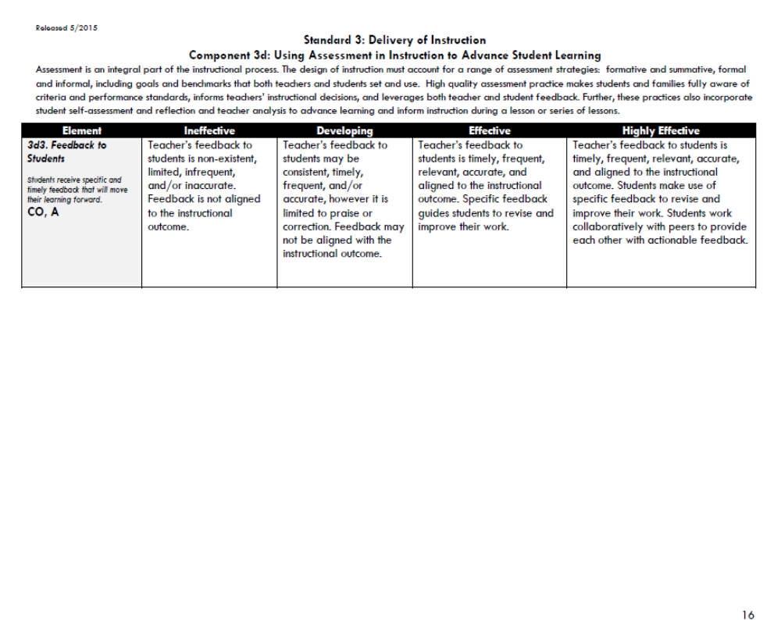

Slide 6
EASEL
In your grade level, use your phrases from your chapter in CCSS in Diverse Classrooms to create a Song Sploosh.

Slide 7
EASEL SONG SPLOOSH
Read over all the favorite phrases
Practice putting the phrases to “music” by “singing” the lines
Keep in mind dynamics, rhythms and tempo
Refer to the opening with Ms. Wray
Be prepared to perform your piece.

Slide 8
EASEL NONJUDGMENTAL CRITIQUE
When I listened to this Song Sploosh……
I….
noticed
wondered
imagined
felt
was inspired by/to

Slide 9
EASEL NONJUDGMENTAL CRITIQUE
When I was creating my Song Sploosh……
I….
felt
thought
wondered
hoped
wished

Slide 10
EASEL REFLECTION- PERFORMERS
How was it to create in the group?
When improvising, what does a group member need to keep in mind?
Say one word that describes this experience for you. If someone says the word you were thinking, say the word in a different way.

Slide 11
EASEL REFLECTION- AUDIENCE
Describe the elements of music you heard.
What did this piece bring to mind or remind you of?
Say one word that describes what you saw, experienced, felt or imagined.

Slide 12
English Learner Master Plan pg. 51
Instructional Guiding Principles
ELs and SELs possess a variety of linguistic and cultural abilities viewed as assets.
Focused instruction for these students builds on cultural and linguistic strengths and provides meaningful access to a curriculum that is standards-based, cognitively complex, rigorous and coherent.
All teachers of ELs and SELs are teachers of both language and content.
Notes:
Tell participants that when working with ELs and SELs our instructional guiding principles are found in the EL Master Plan.
All students come to us with assets and instruction for ELs and SELs should build on the students strengths.

Slide 13
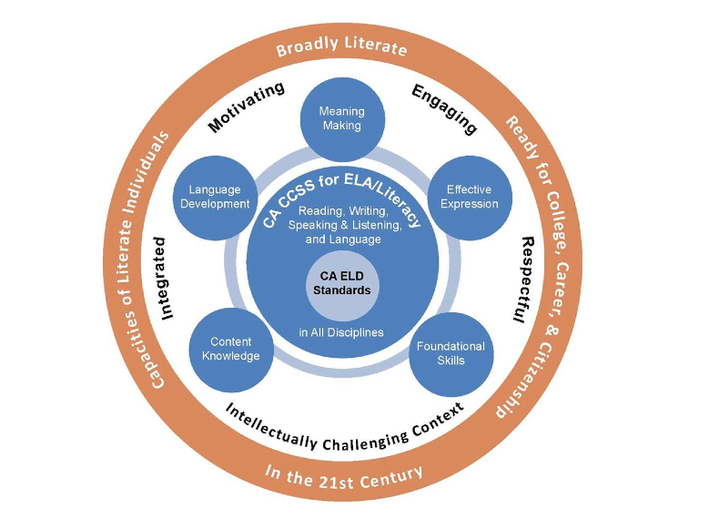

Meaning
Making
Language Development
Effective Expression
Content Knowledge
Foundational Skills
Source: ELA/ELD Framework Chapter 2 p. 4
Notes:
(2 minutes)
Key Themes of ELA/ELD Framework Graphic
Say: This particular graphic helps teachers understand the goals, context, and purpose of the ELA/ELD Framework. If you look at the the middle (white ring) of the graphic you will see the words: Motivating, Engaging, Respectful, Intellectually Challenging Context, and Integrated. This middle ring speaks to the Instructional Context for Learning within the Framework. This context is culturally and linguistically responsive as it is outlined in the framework
The following guiding principles and beliefs informed the development of the framework: • ?Schooling should help all students achieve their highest potential. • ?The responsibility for learners’ literacy and language development is shared. • ?ELA/ELD curricula should be well designed, comprehensive, and integrated. • ?Effective teaching is essential to student success. • ?Motivation and engagement play crucial roles in learning.

Slide 14
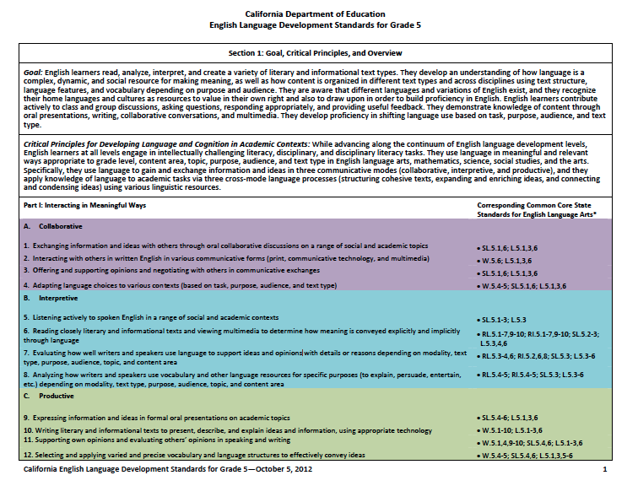
Section I, Part I: Interacting in Meaningful Ways
Table Copy
Notes:
2 mins
These slides are all connected, but should be chunked
Why/Purpose: to understand the layout of the new ELD Standards
How:
We’ve had an opportunity to look at our grade level standards. Now we are going to look at the structure, layout and the various components within each grade level.
The grade-specific standards are divided into two sections.
Section 1 has 3 parts: Part I: Interacting in meaningful ways, Part II How English works and Part III Foundational Skills
This section highlights: Part 1 of the CA ELD Standards Interacting in Meaningful Ways. I

Slide 15
Developing Content and Language Objectives and Guiding Questions
Notes:
30 seconds on this slide.
Clarify that when we develop lesson objectives for the ELD block of time, we refer to those as ELD Objectives.

Slide 16
What is the difference between content objective and language objectives?
The content objective tells what students will learn during the lesson.
Example: “Today you will learn about the causes of the American Revolution.”
The language objective tells how the students will learn and/or demonstrate their mastery of the lesson by reading, speaking, writing, or listening.
Example: You will be able to compare and contrast with a partner the causes of the French and Indian War and the American Revolution by creating a Double Bubble Map.
A guiding question is the fundamental query that directs the search for understanding!
Example: How did the development of the colonies lead to rebellion?

Slide 17
Checklist for Evaluating Content and Language Objectives
The objectives are observable.
The objectives are written and presented in language the students can understand.
The content objective is related to the key concept of the lesson.
The language objective promotes student academic language growth (it is not something most students already do well).
The language objective connects clearly with the lesson topic or lesson activities.
I have a plan for assessing student progress on meeting these objectives during the lesson.

Slide 18
Developing Content Objectives
Visual and Performing Arts Content Standards
Content
Objective
Artistic Perception 1.1
Perceive and describe rhythm and movement in works of art and in the environment
Content Objective Example:
Students will be able to identify and describe movement in a work of art.
Notes:
3 min. slide
Explain that when developing a content objective you start with your CCSS and/or Content Standards (Read CCSS ELA RL3.4).
Click animation:
To demonstrate their learning in working towards the standard, what will students be able to do during the course of that lesson or series of lessons. (Read Content Objective Example).

Slide 19
Developing Language Objectives
Artistic Perception 1.1
Perceive and describe rhythm and movement in works of art and in the environment
Content Objective Example:
Students will be able to identify and describe movement in a work of art.
Language Objective directly supports the content objective.
Students will be able to describe movement in a work of art using adverbial phrases with a partner and in an oral presentation.
Notes:
1 minutes for this slide
Here is a CCSS ELA Standard, RL3.4 (allow time for participants to read the standard).
Based on that standard, we created a Content Objective (allow time for participants to read the example)
Click on animation (Lang. Obj. text box):
Teachers of ELs need to create language objectives to support ELs linguistic needs within the content areas (i.e. math, social studies, etc.).

Slide 20
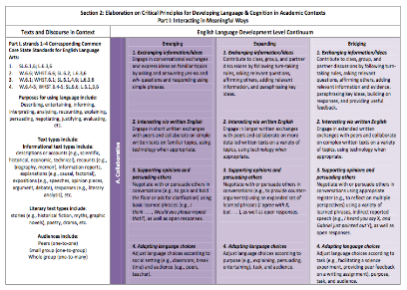
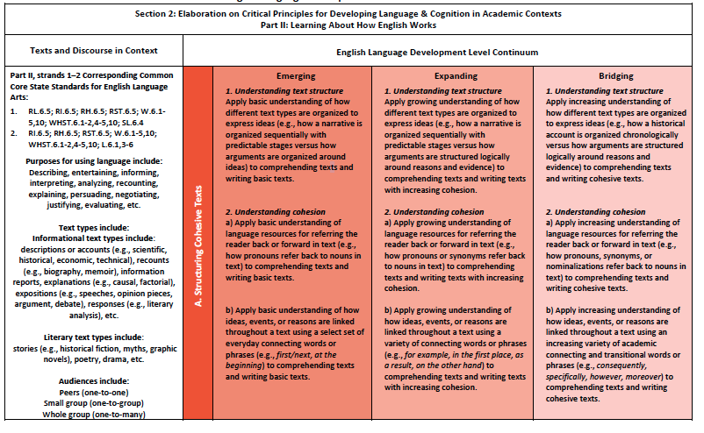
Developing Language Objectives
Content Objective and ELD Standards
Language Objective
Students will be able to (function) (content) using (form/specific language) in a (type of engagement activity).
Part I: Interacting in Meaningful Ways
Part II: Learning About How English Works
Notes:
2 minutes for this slide
To create a language objective, we need our content objective AND the ELD Standards
Click on animation (color coded sentence and ELD Standards):
Here is a frame to guide us in developing a language objective.
Click on animation (yellow arrow):
We look to our content objective to consider how students will use language to express their understanding of the content (the function).
Click animation (red arrow):
For the form, specific language, and type of engagement activity, we look to our CA ELD Standards Part I and II.

Slide 21
A guiding question is the fundamental query that directs the search for understanding!
Besides making connections by bridging what they learn to new situations and content, the goal is for students to demonstrate knowledge of the lesson by responding to essential guiding questions.

Slide 22
Guiding Questions are succinct but demand a lot! ~Traver, R.
Guiding questions and student misconceptions need to be strategically planned before lesson is taught.
Guiding question needs to be posted along with objective so that students can refer back to it.
Everything in the lesson is studied for the purpose of answering it.
They provide focus and coherence.
They Guide students thinking.
They focus students’ attention on the essential aspect of the lesson.
They are purposeful.
They are strategically referred back to during the course of the lesson.

Slide 23
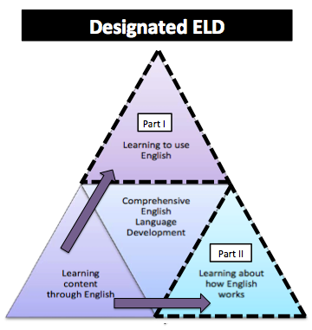
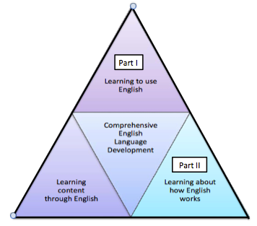
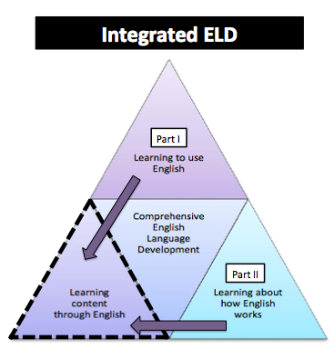
Comprehensive ELD
Handout #5
Notes:
1 minute on this slide
A Comprehensive ELD program includes both Designated and Integrated ELD.
Click animation (Designated ELD):
Designated ELD is the specific time of the day in which students are learning English.
Click animation (Integrated ELD):
Integrated ELD is throughout the day as ELs are learning content and the language of the discipline.

Slide 24
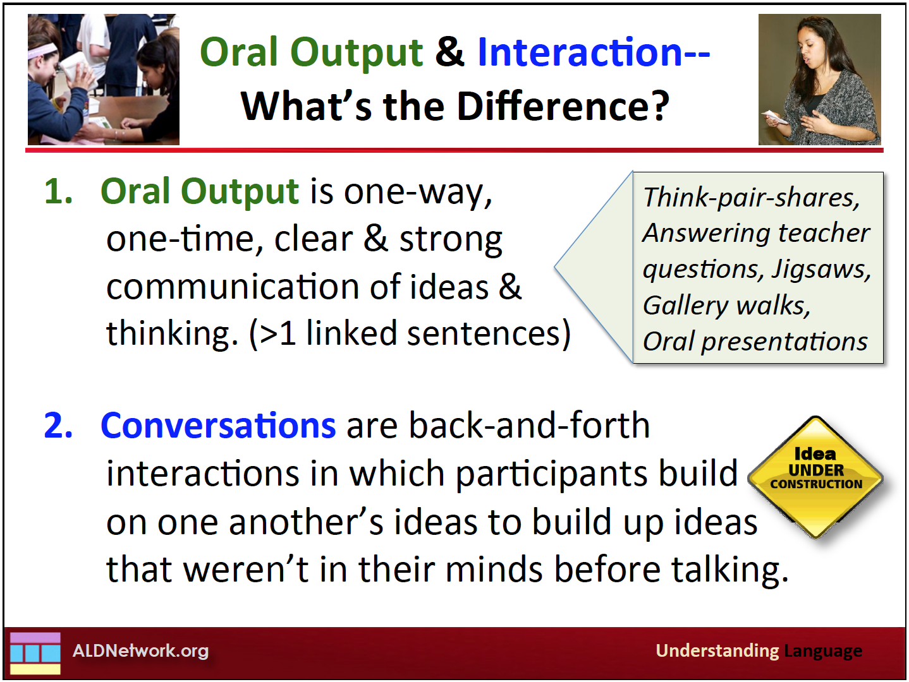
z
Notes:
Slides 9-13 (20 minutes)
(2 minutes)
We want to distinguish the difference between Oral Output and Conversations.
A good example could be giving a speech versus having a conversation.

Slide 25

The Constructive Conversation is an effective instructional
strategy for all students.
It aligns with all Common
Core and ELD standards.
The four Constructive Conversation skills (Create, Clarify, Fortify & Negotiate) live in all Common Core and ELD standards.

Slide 26
In the arts, the Constructive Conversation Skills can be used to:
Role and Development of the Visual Arts
3.3 Distinguish and describe representational, abstract, and nonrepresentational works of art.
Development of Dance Vocabulary
1.5 Describe dance elements used in personal work and that of others.
Compose, Arrange, and Improvise
2.4 Create short rhythmic and melodic phrases in question-and-answer form.
Development of Theatrical Skills
2.1 Participate in cooperative script writing or improvisations that incorporate the Five Ws.

Slide 27
Constructive Conversation Skills and Visual Arts
Role and Development of the Visual Arts
3.3 Distinguish and describe representational, abstract, and nonrepresentational works of art.
Look at a painting. What do you see? Use the language of art (lines, shapes, colors). Refer to handouts in Inner-City Arts orange folder.
Clarify, Negotiate- What do you think happened before the scene in the painting? What do you think will happen next? Why?
(This is similar to what you did during the 15 day Start Smart.)

Slide 28
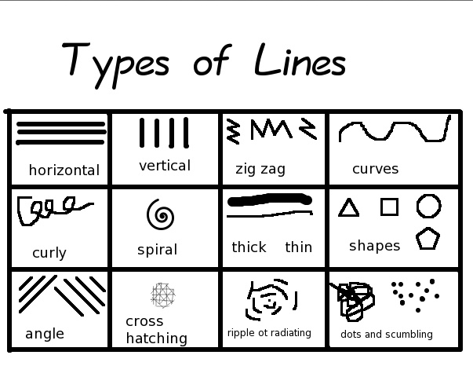

Slide 29


Slide 30
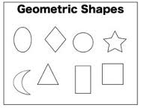

Slide 31


Slide 32
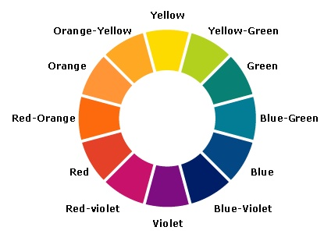

Slide 33
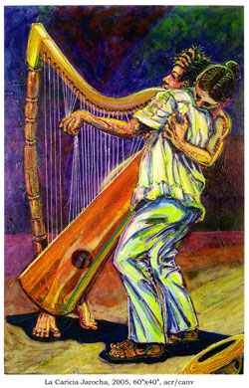

Slide 34
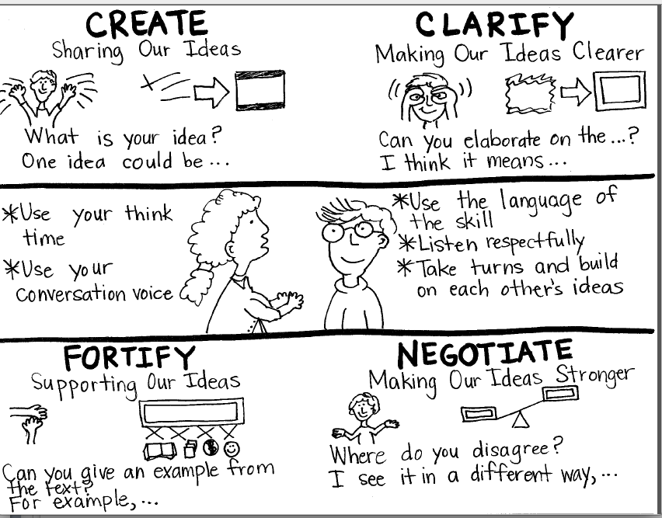
Handout #9
Notes:
30 seconds

Slide 35
Constructive Conversation Skills and Visual Arts
Create a piece of art (railroad board sculpture, Mandala, etc.) Refer to handouts in Inner-City Arts orange folder.
Engage in a gallery walk. Half the room stands by their piece while the other half walks around. Ask the artists questions to clarify, fortify, etc.
Or all walk. What did you observe? What do you see that is interesting and why?
Create a piece of art with a partner. You may use 3 kinds of lines and 2 colors. Negotiate with your partner.

Slide 36
Constructive Conversation Skills and Visual Arts
5. Scribbits
Tapping into Engagement-
Making connections to ELA…

Slide 37
EASEL NONJUDGMENTAL CRITIQUE
When I looked at your
Drawing Mandala Sculpture
I….
noticed
wondered
imagined
felt
was inspired by/to

Slide 38
EASEL NONJUDGMENTAL CRITIQUE
When I was creating my
Drawing Mandala Sculpture
I….
felt
thought
wondered
hoped
wished

Slide 39
Constructive Conversation Skills and Theatre
Development of Theatrical Skills
2.1 Participate in cooperative script writing or improvisations that incorporate the Five Ws.
Pantomime- Hey, everybody, let’s….
Yes, let’s…
(must be an action word- no sleeping, resting, etc.)
2. Tableau- Refer to handouts in Inner-City Arts orange folder. Use your Song Sploosh to create a tableau. Negotiate before create. Unfreeze, tell what you see. Fortify.
3. Pantomime-create a story with a problem. Partner up, share, give feedback.

Slide 40
Constructive Conversation Skills and Theatre
4. Pantomime-or, in groups, simulate a sport. What was the evidence? How do you know?
Tapping into Engagement-
Making connections to ELA…

Slide 41




Slide 42
EASEL NONJUDGMENTAL CRITIQUE
When I watched your
Tableau Pantomime
I….
noticed
wondered
imagined
felt
was inspired by/to

Slide 43
EASEL NONJUDGMENTAL CRITIQUE
When I was creating my/our
Tableau Pantomime
I….
felt
thought
wondered
hoped
wished

Slide 44
EASEL REFLECTION- PERFORMERS
How was it to create in the group?
How did you use the Constructive Conversation Skills in your group?
Say one word that describes this experience for you. If someone says the word you were thinking, say the word in a different way.

Slide 45
EASEL REFLECTION- AUDIENCE
Describe the elements of theatre you saw.
What did this piece bring to mind or remind you of?
Say one word that describes what you saw, experienced, felt or imagined.

Slide 46
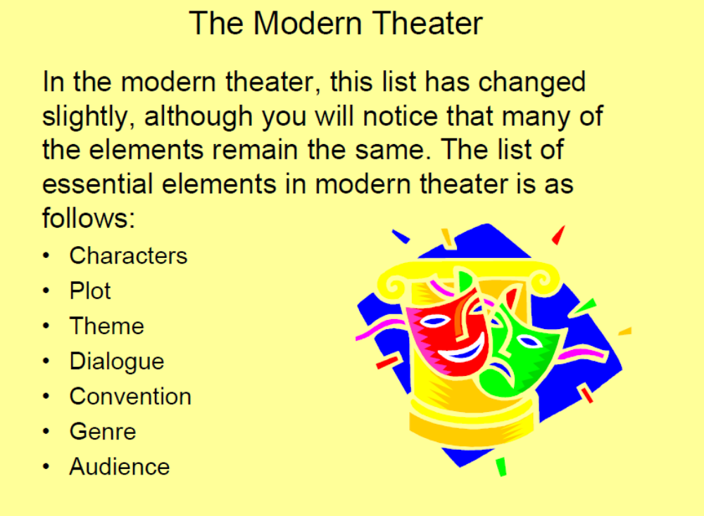

Slide 47
Constructive Conversation Skills and Dance
Development of Dance Vocabulary
1.5 Describe dance elements used in personal work and that of others.
Baseball- action (ball), gesture (umpire)- now abstract it
Play “Take Me Out to the Ballgame” with no lyrics.
For 8 counts- form groups of 4 and get into a diamond shape.
Copy each other’s movements, turn to the right, copy the next, etc.
Describe percussive (sharp) or sustained (flowing) movements.

Slide 48
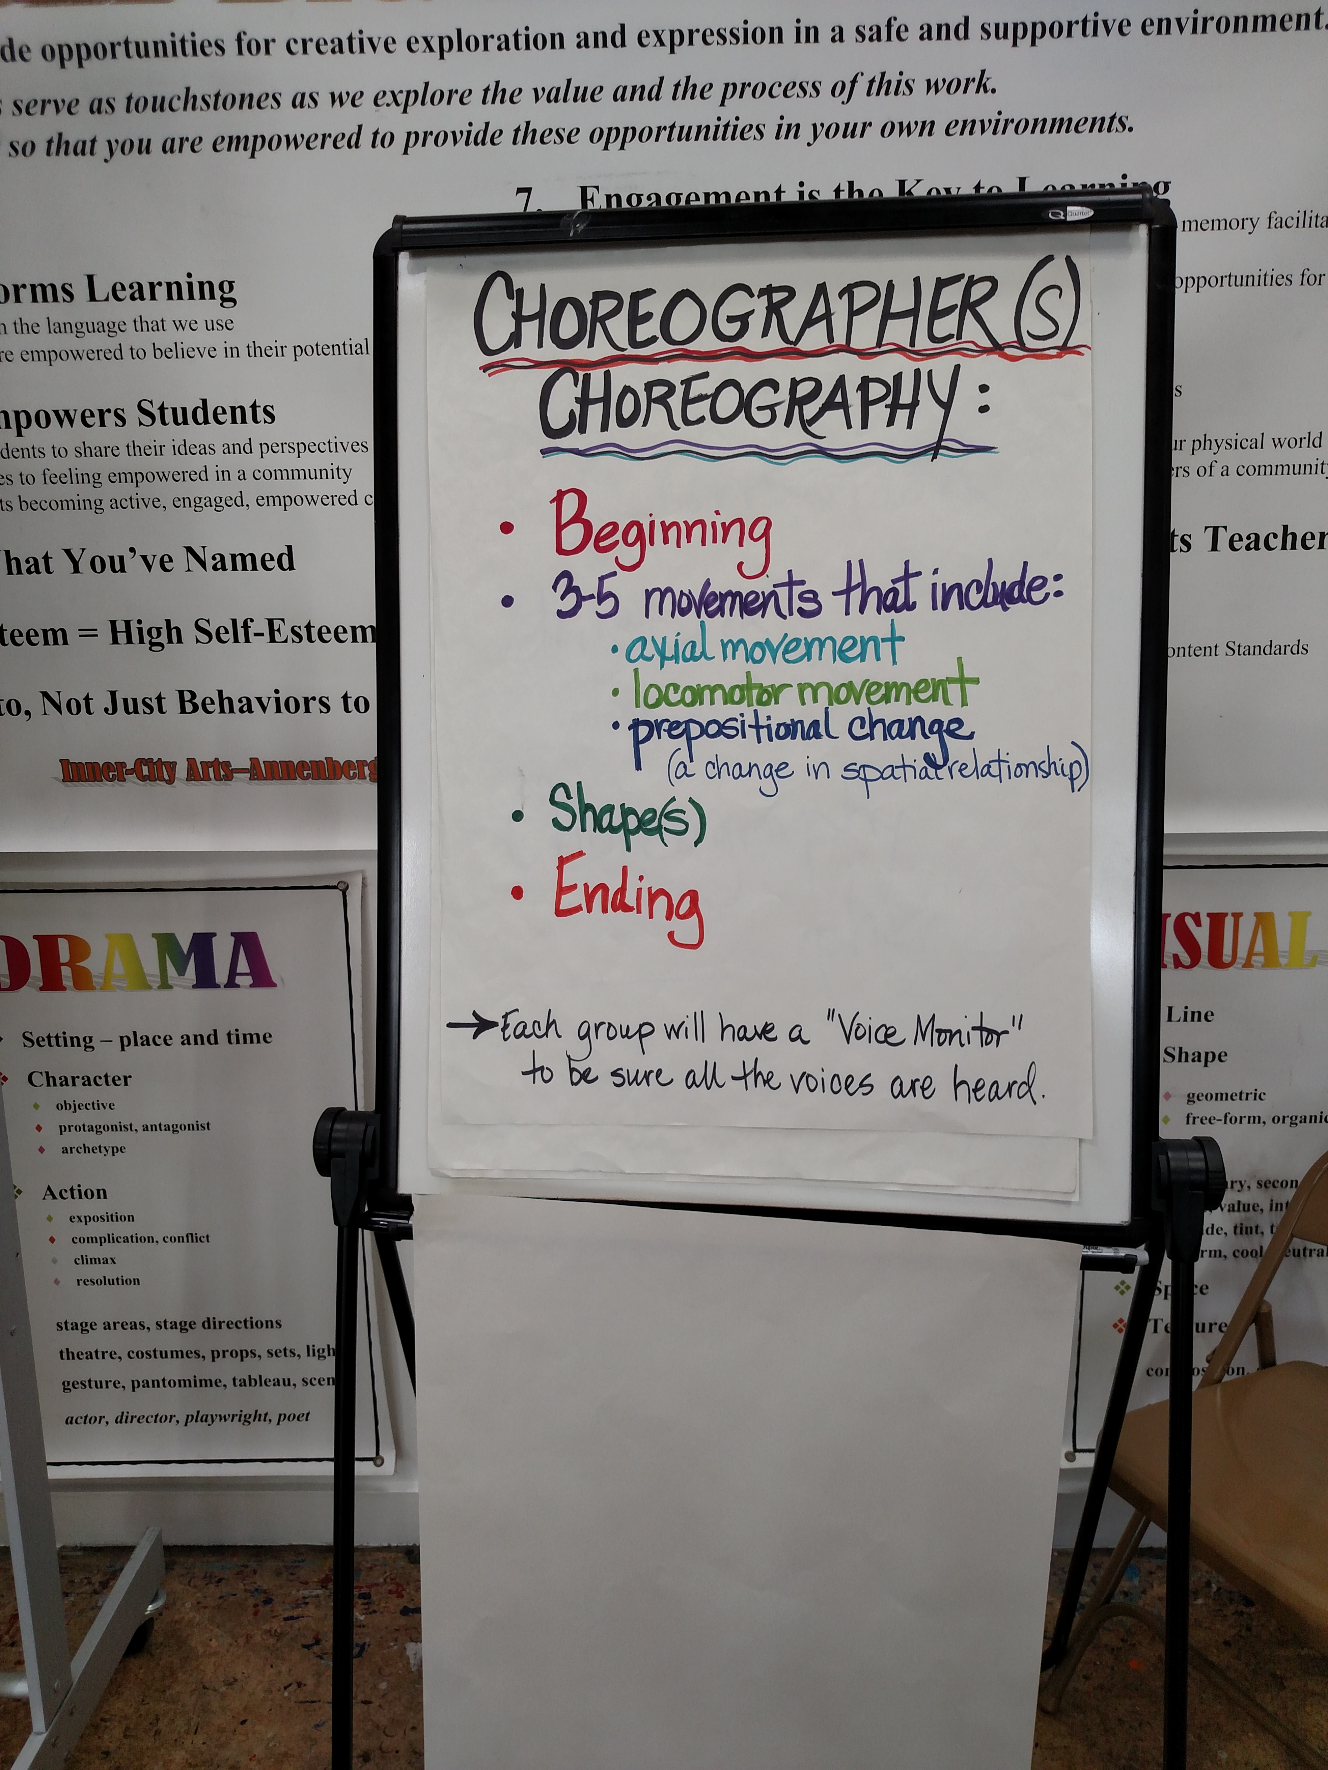

Slide 49
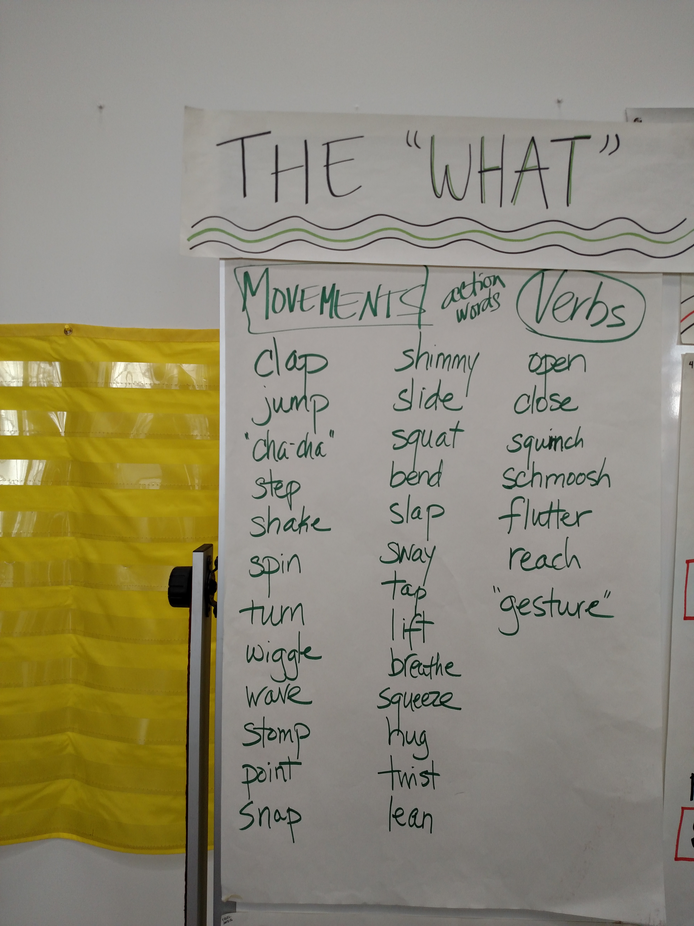

Slide 50
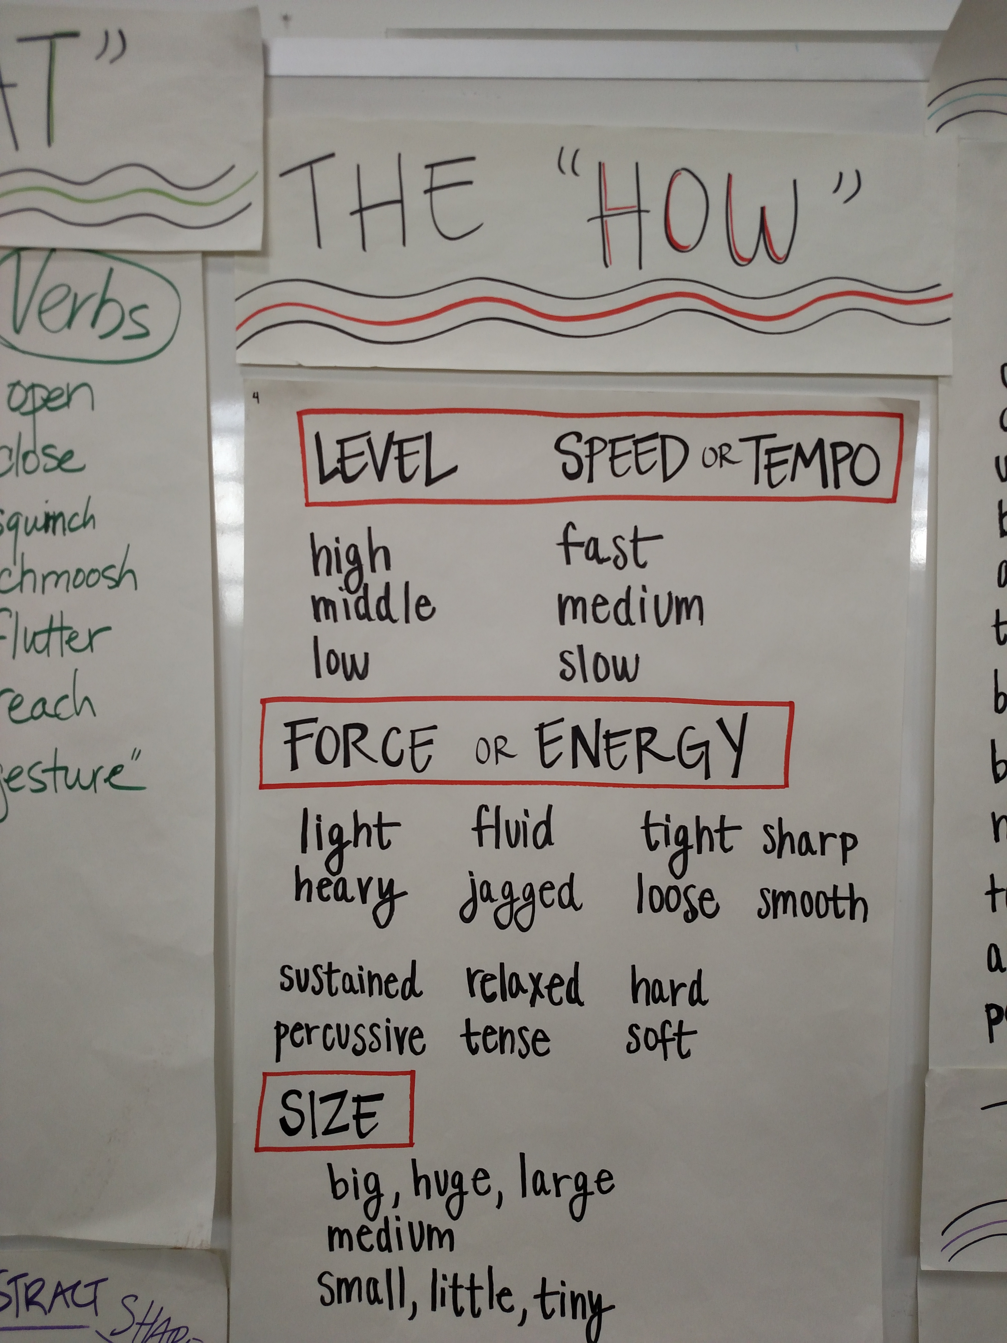

Slide 51
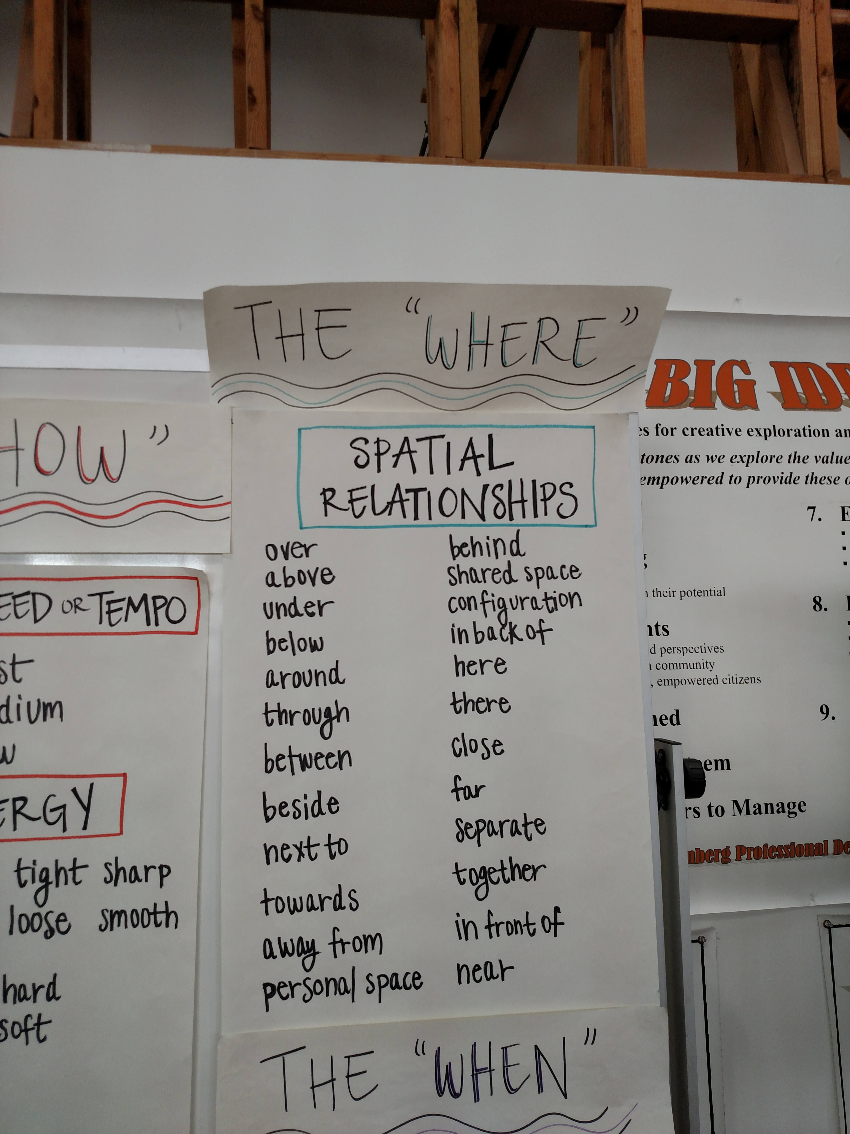

Slide 52
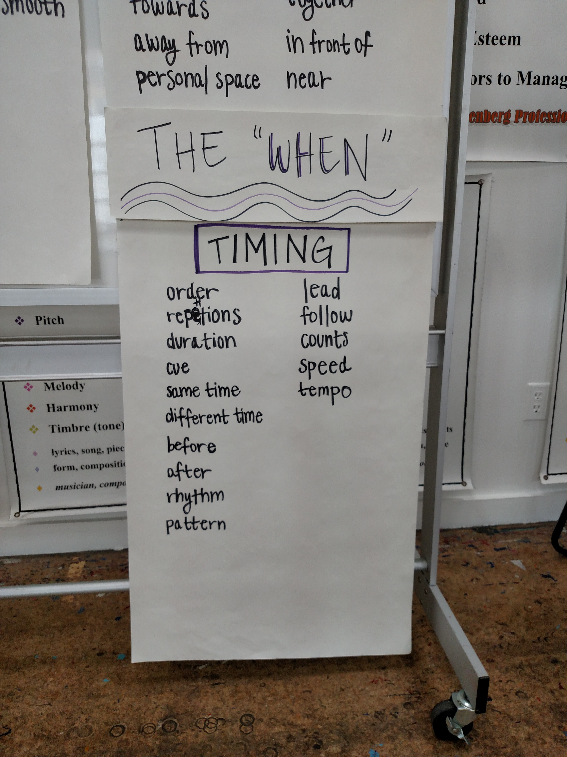

Slide 53
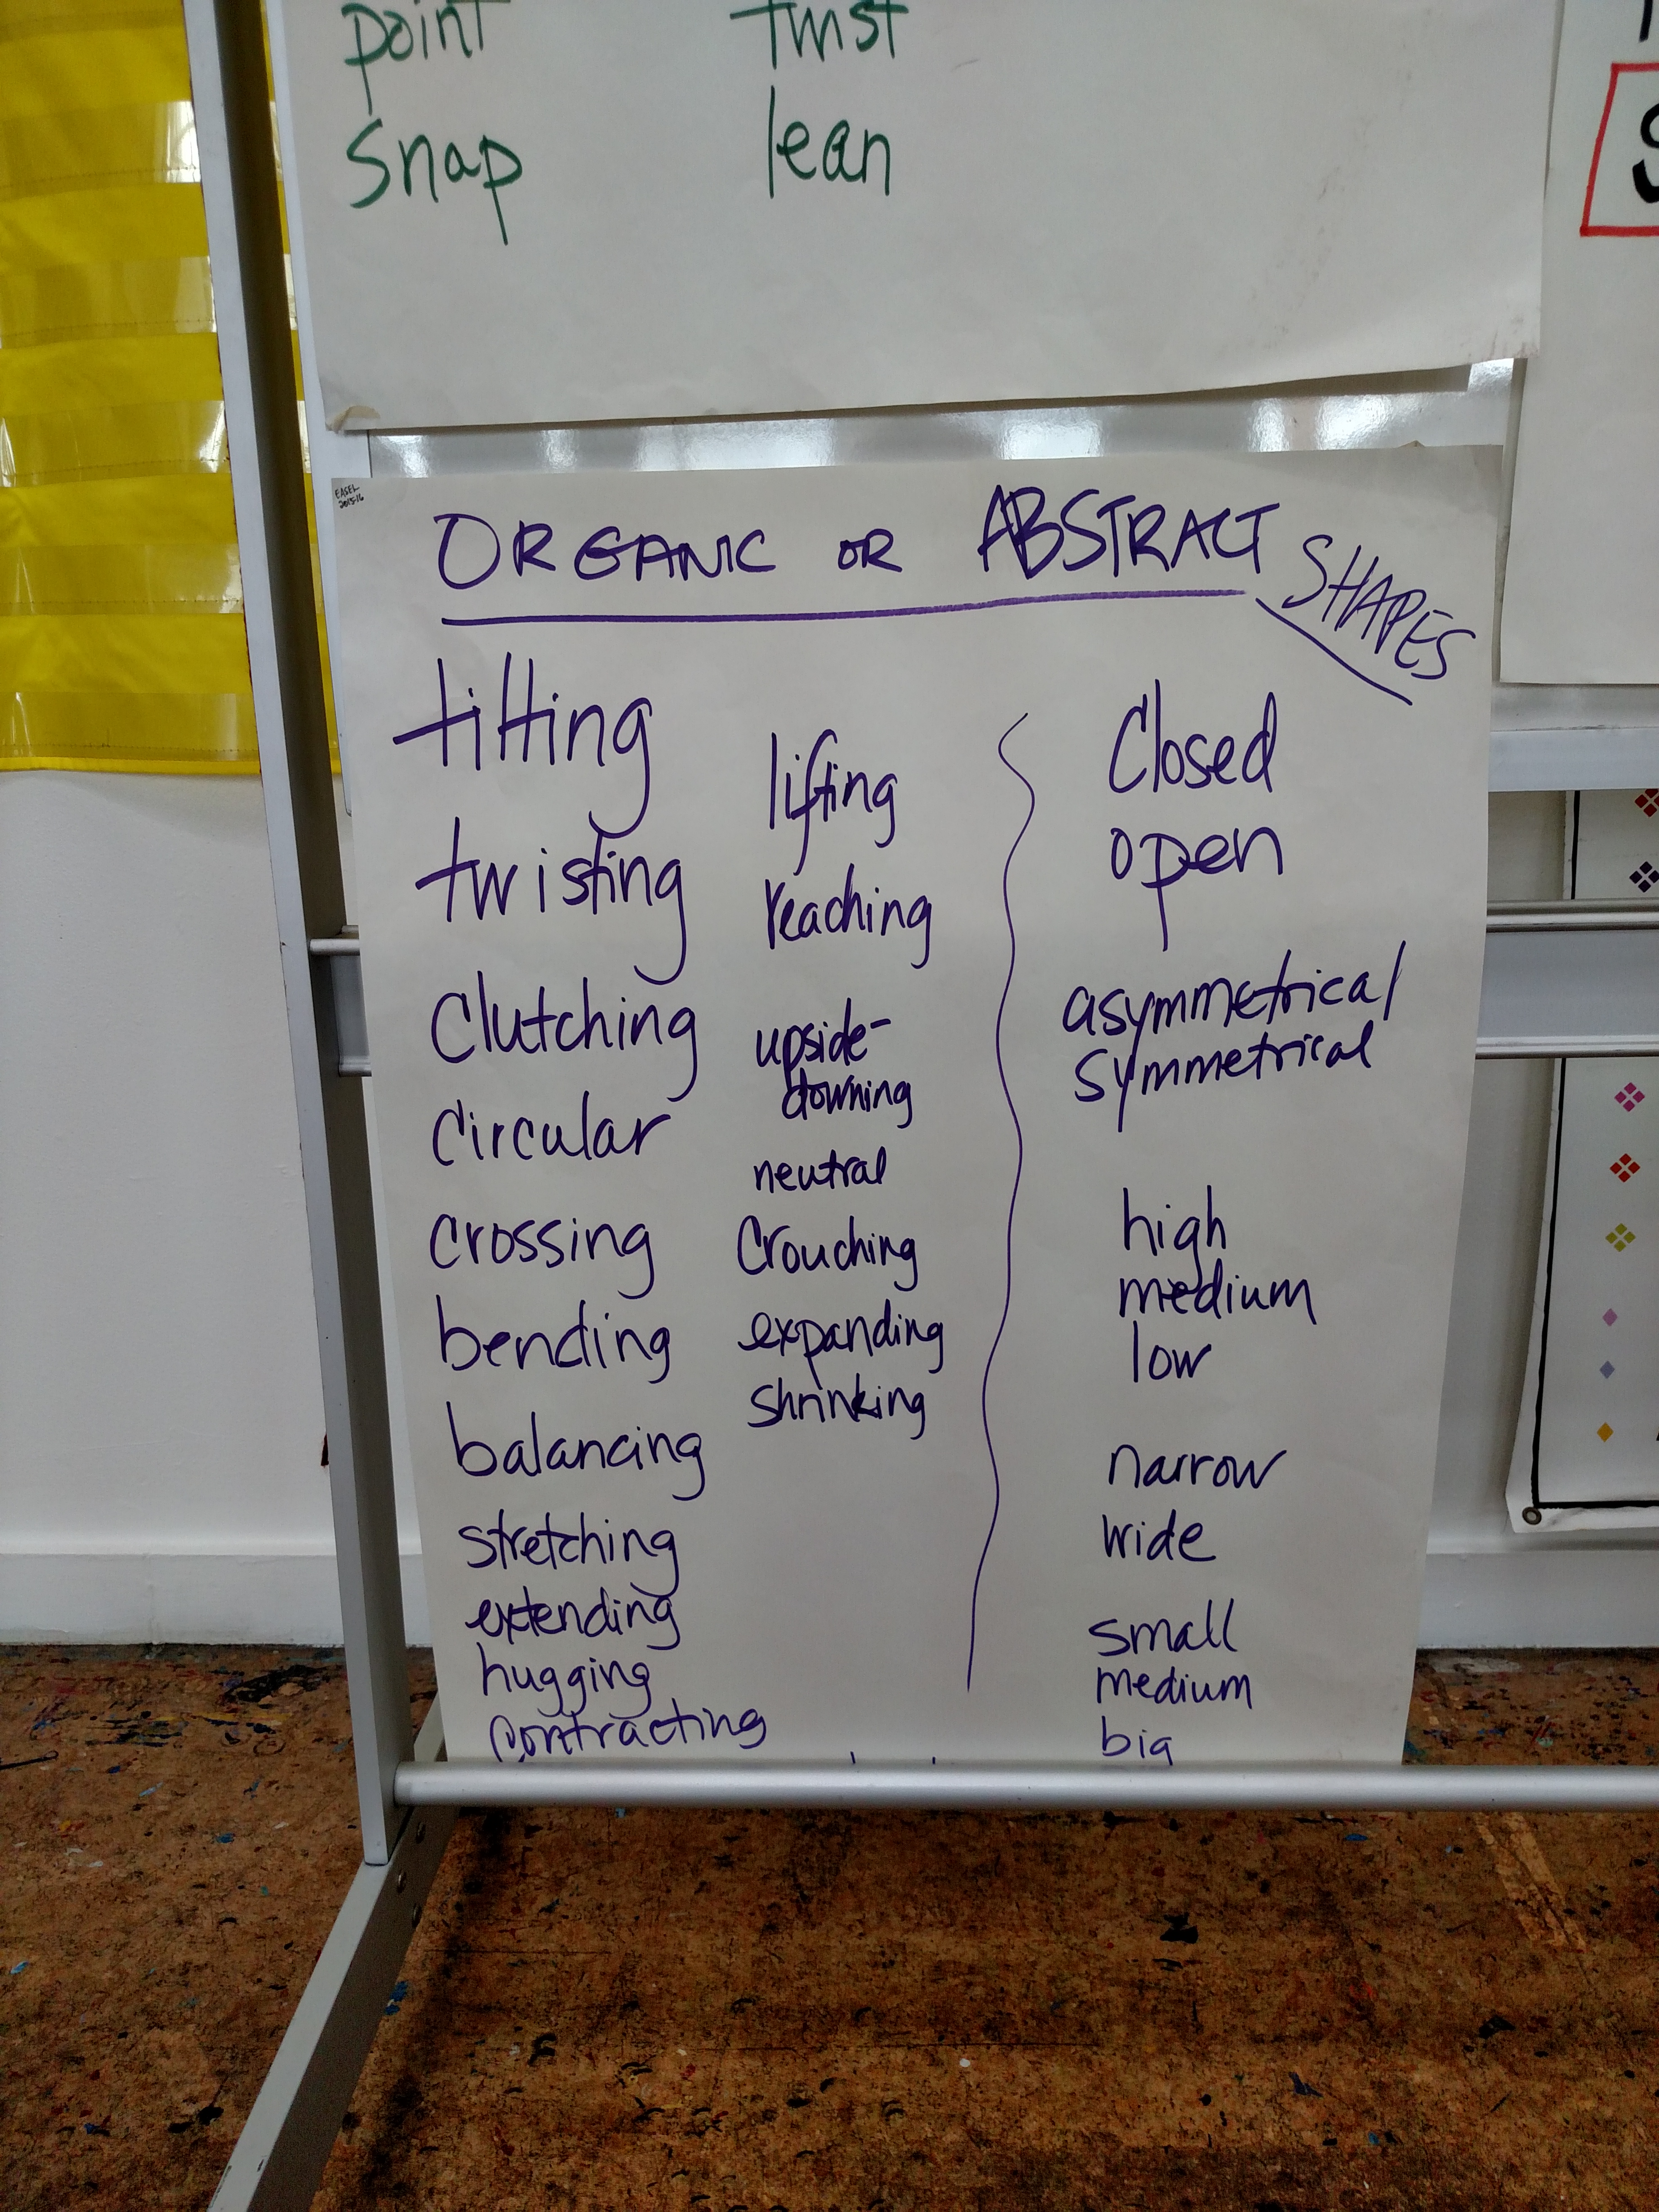

Slide 54
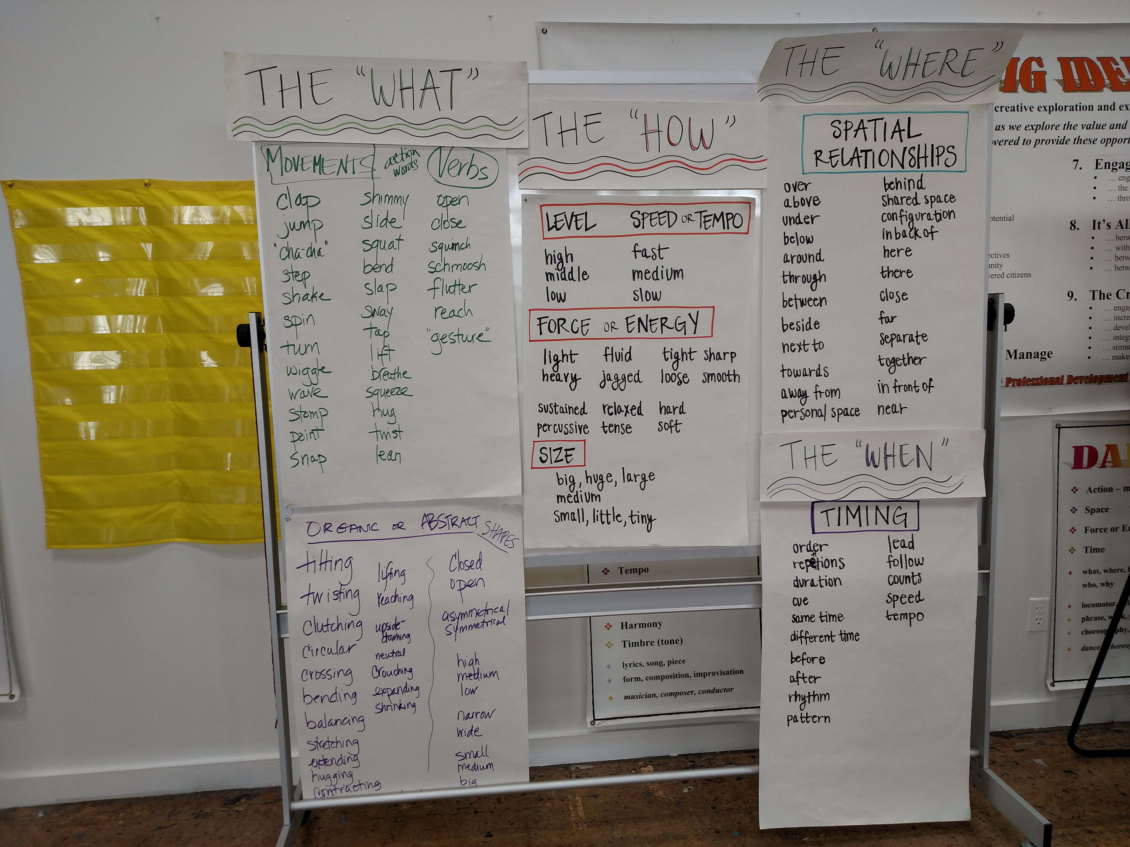

Slide 55
Constructive Conversation Skills and Dance
Tapping into Engagement-
Making connections to ELA…

Slide 57
EASEL NONJUDGMENTAL CRITIQUE
When I watched your dance…
I….
noticed
wondered
imagined
felt
was inspired by/to

Slide 58
EASEL NONJUDGMENTAL CRITIQUE
When I was creating my/our dance…
I….
felt
thought
wondered
hoped
wished

Slide 59
EASEL REFLECTION- PERFORMERS
How was it to create in the group?
How did you use the Constructive Conversation Skills in your group?
Say one word that describes this experience for you. If someone says the word you were thinking, say the word in a different way.

Slide 60
EASEL REFLECTION- AUDIENCE
Refer to the criteria chart. What evidence did you see of all elements?
What did this piece bring to mind or remind you of?
Say one word that describes what you saw, experienced, felt or imagined.

Slide 61
Constructive Conversation Skills and Music
Sit and listen to a piece of music with the lights dim. What kind of instruments do you hear? What is the mood? What was the composer thinking about?
In groups, create a word wall of adjectives to describe the piece using one color of ink.
Engage in a gallery walk. Use a different color marker to Clarify and Fortify.
Listen to a second piece of music. Repeat above. Compare and contrast the songs. Which one did you like better and why? (Negotiate)

Slide 62
Constructive Conversation Skills and Music
Compose, Arrange, and Improvise
2.4 Create short rhythmic and melodic phrases in question-and-answer form.
1. Read a fable, poem or short story.
2. Create word walls as in previous activity.
3. In groups, use the classroom instruments to compose and play music that reflects the words on the word wall.
4. Or, do a Song Sploosh (see handout from 01/12/16) and use those words to create an instrumental piece.

Slide 63
Constructive Conversation Skills and Music
Tapping into Engagement-
Making connections to ELA…

Slide 64
EASEL NONJUDGMENTAL CRITIQUE
When I listened to your…
I….
noticed
wondered
imagined
felt
was inspired by/to

Slide 65
EASEL NONJUDGMENTAL CRITIQUE
When I was creating my/our…
I….
felt
thought
wondered
hoped
wished

Slide 66
EASEL REFLECTION- PERFORMERS
How was it to create in the group?
How did you use the Constructive Conversation Skills in your group?
Say one word that describes this experience for you. If someone says the word you were thinking, say the word in a different way.

Slide 67
EASEL REFLECTION- AUDIENCE
Describe the elements of music you heard.
What did this piece bring to mind or remind you of?
Say one word that describes what you saw, experienced, felt or imagined.

Slide 68
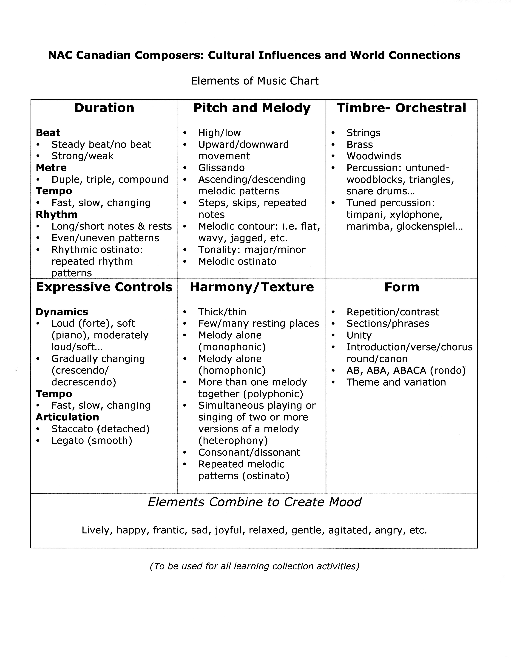

Slide 69

Content Areas/or Grade Levels
Design an Integrated ELD and the Arts lesson.
Criteria:
1. ELD Standard ( if teaching ELs), ELA if not
2. Arts Content Standard
3. Content Objective
4. Language Objective
5. Constructive Conversation Skills
6. Non-judgmental Critique
7. Actionable Feedback

Slide 70
In the arts, the Constructive Conversation Skills can be used to:
Role and Development of the Visual Arts
3.3 Distinguish and describe representational, abstract, and nonrepresentational works of art.
Development of Dance Vocabulary
1.5 Describe dance elements used in personal work and that of others.
Compose, Arrange, and Improvise
2.4 Create short rhythmic and melodic phrases in question-and-answer form.
Development of Theatrical Skills
2.1 Participate in cooperative script writing or improvisations that incorporate the Five Ws.

Slide 71
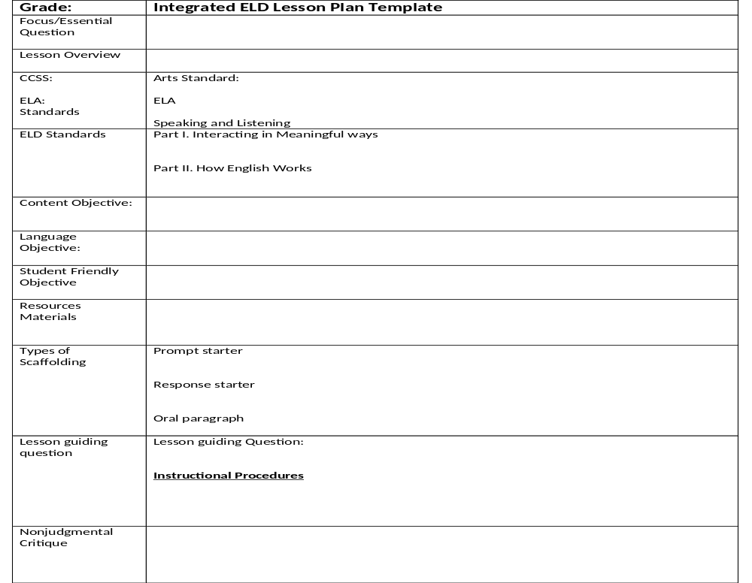

Slide 72
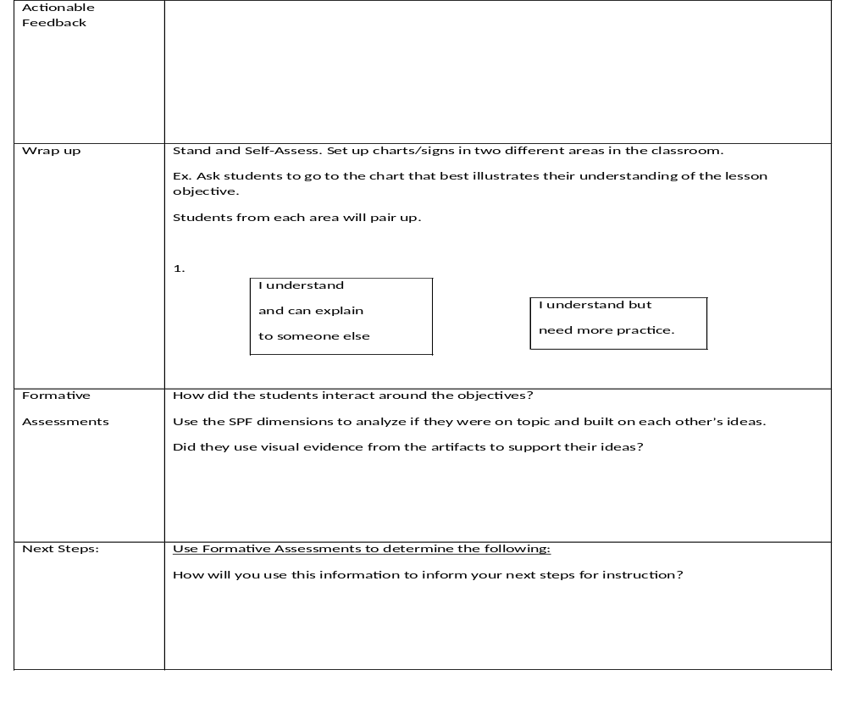

Slide 73

Entire Group
Share your group’s Model Constructive Conversation with the whole group

Slide 74
Students are Resources to Tap Into, Not Just Behaviors to Manage.
Behaviors that seem “out of bounds” or “off-task” are often indicators of a student’s strengths, natural inclinations for ways of learning, unexpressed feelings or unmet needs.
Tapping into these inclinations often provides a new idea, direction, perspective or path of accessibility for the individual learners in a group or for the entire group itself.

Slide 75
EASEL NONJUDGMENTAL CRITIQUE
What were some feelings you had when….?
What do you see that’s not working for you?
What do you think you would choose to do differently?

Slide 76
EASEL NONJUDGMENTAL CRITIQUE
When I _________, I ___________
see/saw hope/d
noticed wish/ed
wondered decide/d
feel/felt forget/forgot
want/ed to change/d
think/thought

Slide 77
Constructive Conversation Skills and Behavior
Pantomime- Hey, everybody, let’s….
Yes, let’s…
(must be an action word- no sleeping, resting, etc.)
2. Yes, And…
3. Giving a Gift
4. Tableau- Create a tableau of a behavior issue with traditional discipline. Then, create that same issue with a restorative justice response.
(Inner City Arts Folder, P.A 12-13)

Slide 78
Traditional Discipline
Out of School Discipline
Referral to law enforcement, court fee, fine
In school suspension, privileges removed
Out of School Suspension
Spend time in detention
Be shamed in front of class by teacher

Slide 79
Restorative Justice
Reflective behavioral journal, student safety plan
Return stolen items with apology and pay for replacement
Apologize to teacher and students with promise to behave positively
Clean, repair and restore damage
Letter of apology
Prepare speech about negotiation

Slide 80
Reflection
3 – 2 – 1 Protocol
3 Things You Learned
2 Interesting Things
1 Question You Still Have
Notes:
Slides 50 – 51 (6 minutes)
(4 minutes)
Have teachers reflect using the 3-2-1 Protocol.
Teachers then share their reflection with a partner.

